Slide 1
Software Product Management Create Minimum Viable Product (MVP)
Nandagopal Govindan

Slide 2
Contents
What is MVP?
Types of MVP
When to use which MVP?

Slide 3
Introduction
Product is a risky business
We should not wait to develop all the features to launch it.
Rather we should develop a product with just enough functionality for users to use it meaningfully and derive significant value from it.
Such an approach will reduce risk

Slide 4
What is MVP?
Frank Robinson says ”The MVP is the right-sized product for your company and your customer. It is big enough to cause adoption, satisfaction, and sales, but not so big as to be bloated and risky
Eric Reis says ““The minimum viable product is that version of a new product which allows a team to collect the maximum amount of validated learning about customers with the least effort.”

Slide 5
What is MVP?...
A Minimum Viable Product helps entrepreneurs start the process of learning as quickly as possible. It is simply the fastest way to get through the build-measure-learn feedback loop with the minimum amount of effort.
Its goal is to test fundamental business hypotheses
Is this the need?
Is there enough value? (Product–Market fit)
Does it make business sense?

Slide 6
MVP need not always be a product…
It can be a
Prototype
Video
Anything that allows us to test the value

Slide 7
Different types of MVP

Slide 8
Facebook MVP
Facebook used a simple platform that connected students from the same classes by allowing them to post messages to shared boards.
By introducing Facebook to a super-narrow segment of the market, Zuckerberg managed to validate his idea

Slide 9
Uber MVP
When Uber (then called UberCab) launched in 2009, it only worked on iPhones or via SMS, and it was available only in San Francisco.
Uber’s MVP was enough to prove that the idea of a cheap ride-sharing service had a market.

Slide 10
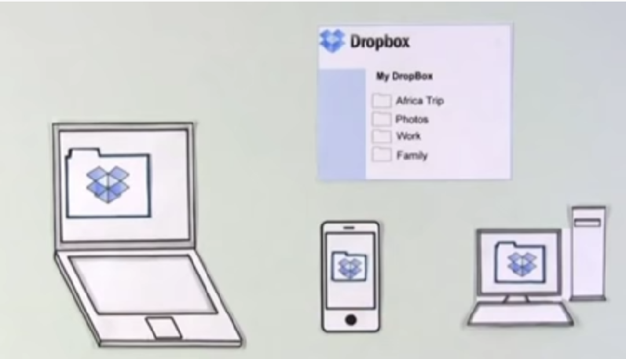
Dropbox MVP
Dropbox used a video to test hypothesis
https://www.youtube.com/watch?v=xy9nSnalvPc&feature=emb_title
The video led to 75,000 people waiting for a beta invite, literally overnight

Slide 11
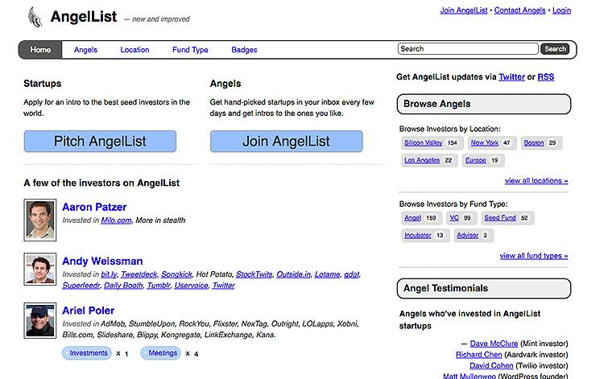
AngelList MVP
AngelList is a vast directory of startups and investors, powered by intelligent match-making algorithms and search functionalities.
Babak and Naval were doing manual email intros between startups and investors using their broad network of contacts.
Only after they saw a potential in their idea, did they build their first website.

Slide 12
‘Buffer’ MVP
Buffer:
Buffer is tool that allows scheduling your Tweets
The founder Joel Gascoigne did something similar to Dropbox’s MVP.
However, instead of a video, the smoke test was a minimal landing page.

Slide 13
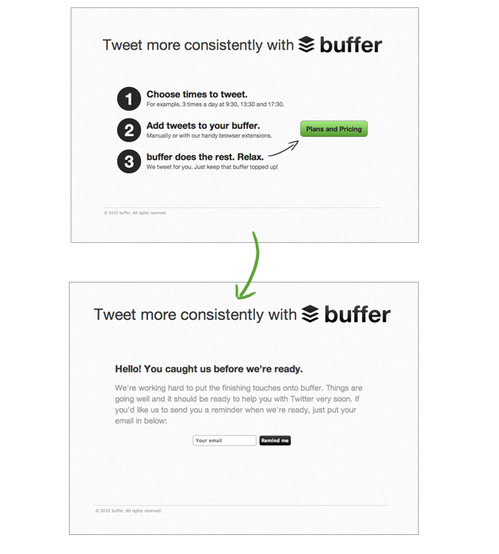
Buffer

Slide 14
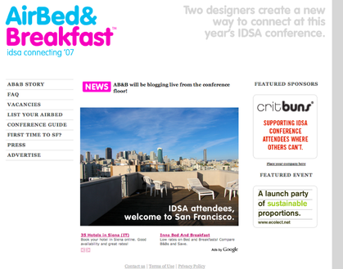
AirBnB MVP
Back in 2007, there was a great design conference in San Francisco. Hotels were over booked
The Airbnb team decided to offer their house on rent
They hacked together a website to advertise.
They got 3 guests.
This supported the market insight that potential customers would be willing to pay to stay at someone else’s home rather than in a hotel.

Slide 15
Aardvark MVP
Wanted to develop a product which will answer questions like ”What is a good place to have Italian food?”
They developed a front-end to ask questions, but these were answered by humans. There was no software in back-end.
Once they found that there was a demand, they automated it. (Lean Startup)

Slide 16
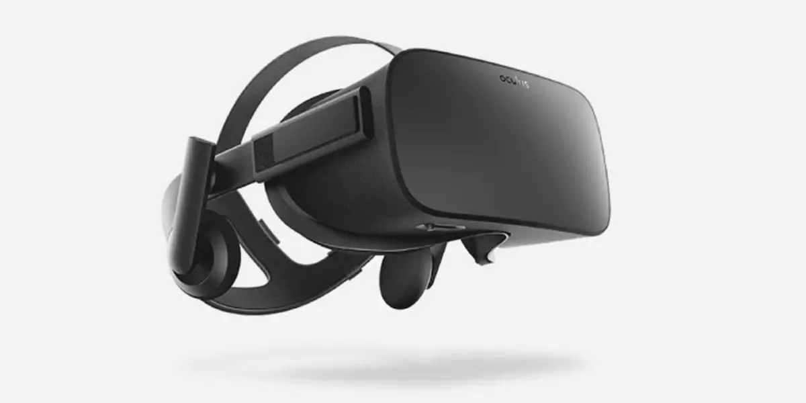
Oculus VR MVP
Oculus VR
Founder/s: Palmer Luckey was 20 years when he got the idea
The Idea: Oculus Rift was created with a simple idea of bringing VR experience to passionate gamers
Crowdfunding: Kickstarter campaign started in 2012
Funded: $2,437,429 USD
Backers: 9,522 people
Business Today: Revenue from Oculus Rift is forecasted to amount to 4.95 billion U.S. dollars worldwide in 2019 and that’s only from hardware
Website: https://www.oculus.com/

Slide 17
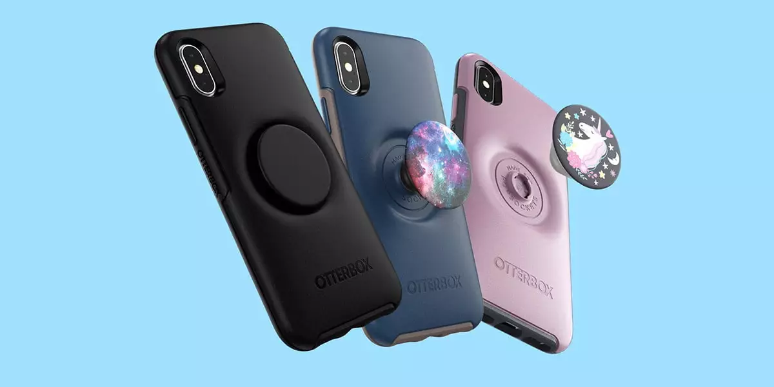
PopSocket MVP
PopSocket
Founder/s: David Barnett, professor of philosophy in Colorado
The Idea: First version of PopSocket was created to keep the cables from the earphones organized and tied to the smartphone
Crowdfunding: Campaign started in 2012 on Kickstarter
Funded: $18,591 USD
Backers: 520 people
Business Today: In 2018, PopSocket LLC’s revenue was over $200 million U.S. dollars, with a profit of over US$90 million.
Website: https://www.popsockets.com/

Slide 18
Summary of MVP types
Video : DropBox
Simple product : Facebook, Uber
Concierage : AngleList, AirBnB
Landing page : Buffer
(Fake door)
Wizard of Oz : Aardwark
Crowdfunding : Oculus
Have you come across any other types of MVP?

Slide 19
When to use which MVP?
MVP type | When to use
Video (Dropbox) | When product is simple and when it is easy to explain using Video
Simple product (Facebook) | When investment is hot high and when experiencing the product is important to get a feel
Concierage - do it manually (AngleList, AirBnB) | When the concept is very new and when developing a simple version is time consuming
Landing page (Buffer) | When you do not have money to develop
Wizard of Oz - do it manually behind the scene (Aardvark) | When developing the product is time consuming
Crowdfunding (Oculus, Popsocket) | When investment is high
Prototype - clickable | When product has many features
What do you think?

Slide 20
Exercise
Which type of MVP would be suitable for these products?
Online library
Software product finder / advisor
Apna – job finder for blue collar workers

Slide 21
Possible solution…
Product | MVP type | Justification
Online library | Video, crowd funding | Expensive to develop – storage, data management, tie up with publishers
Sw product finder / advisor | Do consulting to check demand (Concierage) | New concept. Not sure if there is demand
Apna - job finder for Blue collar | Prototype | Need to feel the product Blue collar workers need to see the product before they can say if it is useful & usable

Slide 22
Experience sharing…
What was the MVP of your product?

Slide 23
Appendix

